Slide 1

Simulating KGD: GF65nm SAR ADC
https://github.com/USCPOSH/AMS_KGD/tree/master/ADC/SAR_ADC/GF65LPe

Slide 2
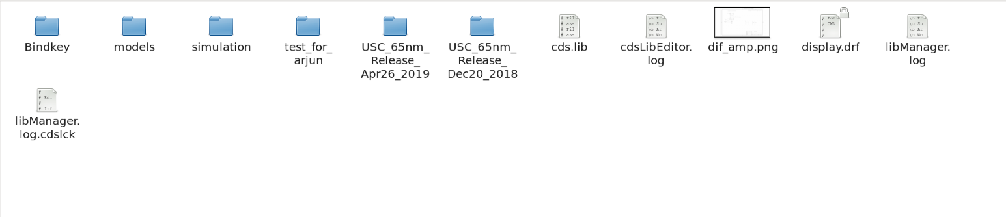
Simulating KGD: GF65nm SAR ADC
1) Copy the library to /workarea_GF55
Testbenches may be found in April 2019 release folder.
https://github.com/USCPOSH/AMS_KGD/tree/master/ADC/SAR_ADC/GF65LPe

Slide 3
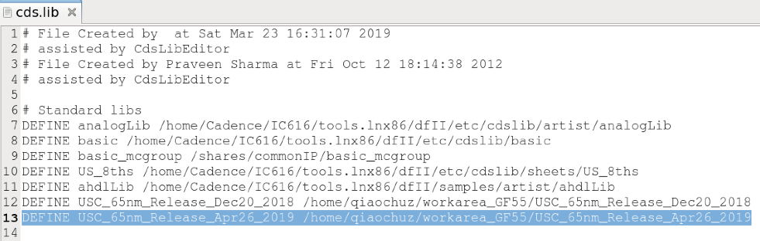


Simulating KGD: GF65nm SAR ADC
2) Add the library to cadence search path
Open cds.lib in /workarea_GF55
Add the line shown below
https://github.com/USCPOSH/AMS_KGD/tree/master/ADC/SAR_ADC/GF65LPe

Slide 4
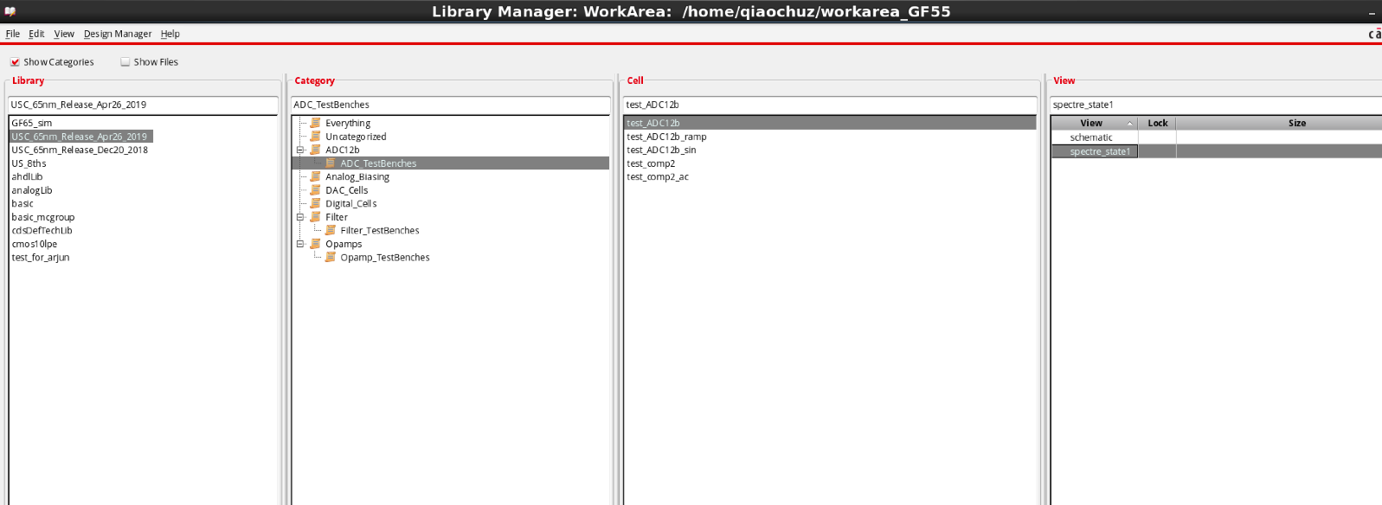
Simulating KGD: GF65nm SAR ADC
3) Open design and find testbenches under corresponding categories
Location of testbenches
https://github.com/USCPOSH/AMS_KGD/tree/master/ADC/SAR_ADC/GF65LPe

Slide 5
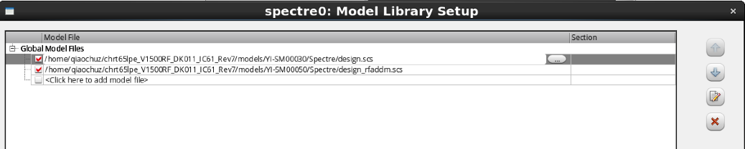
Simulating KGD: GF65nm SAR ADC
4) Change the path of model file
Open ADE L
Click Setup -> Model Libraries
Find the location of your model file
5) Click simulation button!
https://github.com/USCPOSH/AMS_KGD/tree/master/ADC/SAR_ADC/GF65LPe

